Slide 1
FAA Aviation Safety - Bonded Repair Initiative
Progress Update:
Substantiation of Bonded Repair (SoBR) WG
Presented at:
Composites Modifications Workshop
NIAR/NCAT, Wichita KS
July 20, 2016
Michael Borgman
Spirit AeroSystems, Inc.
Wichita, KS, USA

Slide 2
What is My Background?
(composites since 1977, 40 years)
Durability and damage tolerance, stress analysis and methods development, structural test, effects of defects, bonded repair, manufacturing
  1977 Composite shop mechanic
  1978 Composite shop foreman
  1979 Composite shop Production Manager
  1982 research assistant (with D F Adams)
  1988 Tomahawk and Advanced Cruise Missiles (stress & full-scale test)
  1989 F-16, A-12, X30, F-22 (DADT and Stress)
  1995 Premier 1
  1996 Single and Twin Aisle Thrust Reverser, Fan Cowl, Inlet
  2001 787 Fuselage (S41)
  2007 G650 Thrust Reverser, Fan Cowl, Inlet
  2009 A350 Fuselage (S15) to present

Slide 3
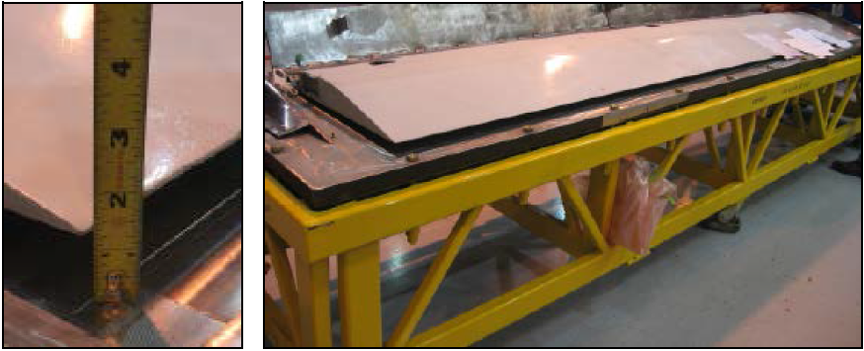
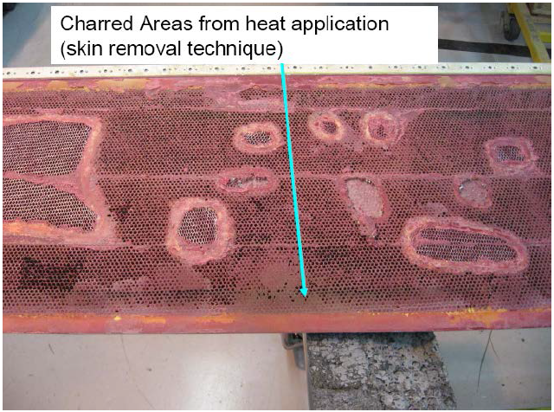
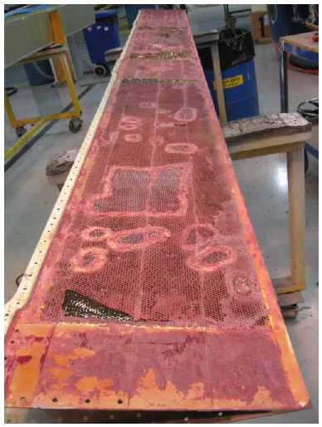
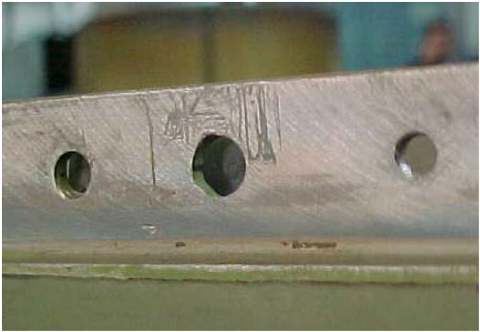
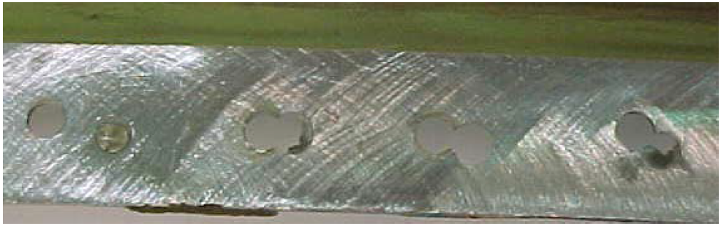
DOT/FAA/TC-14/20
Nonconforming Composite Repairs: Case Study Analysis
Variable (Poor) Quality Found In-Service

Slide 4
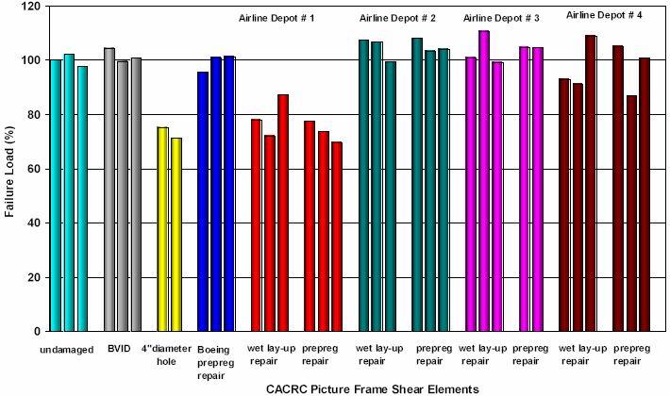
Variable Strength Performance Of “Same” Repair Observed When Performed By Multiple MRO’s
DOT/FAA/AR-03/74, February 2004 (first of two studies)
Variable (Poor) Performance Observed

Slide 5
Current Situation
Bonded Repair of PSE and Non-PSE
Absence of harmonized approach to bonded repair approvals is risk of inadequate repairs in service
  Poorly performed repairs have been found in-service
  Insufficient guidance exists on repair substantiations
  Risk of inadequate bonded repairs on newly emerging composite PSE’s
  Additional guidance and policy referencing common knowledge would help mitigate this risk

Slide 6
Targets For Improvement
Bonded Repair of PSE and Non-PSE
Update
  Existing standards to reflect current best practices in bonded repair substantiation
Expand
  Existing standards to include substantiation examples
Create
  New standards with details on the bonding process and key process parameters
  New policy and guidance referencing the updated standards

Slide 7
Proposed Actions
Bonded Repair of PSE and Non-PSE
Improve/Create “industry consensus” standards
  Bonded Repair Size Limits
  Update/Expand existing information in CMH-17
    “Supportability” (Vol 3, Chapter 14)
    Add example substantiations as new section
  CACRC AIR6292 “Fiber-Reinforced Repair Guidelines”
Create short-course for designees
Improve maintenance training guidance
  Update AC 65-33
Reference output in new guidance and policy

Slide 8
FAA/AVS Bonded Repair Initiatives Timeline
FY 2012 | FY 2013 | FY 2014 | FY 2015 | FY 2016 | FY 2017 | FY 2018
Bonded Repair Size Limits Policy: Create policy to mitigate safety risks associated with bonded repairs to critical structure (composites and metal) for all product types.
Last Mtg
Present
CACRC Metal Bond and Composite Bonded Best Practices (AIRs): Document best practices in metal bonding and composite sandwich bonded repair for previously substantiated repairs.
CMH-17 Composite Repair Structural Substantiation and M&P Controls (Vol. 3 Ch. 14): Document the recommended M&P specifications, qualification, design criteria, analysis and test protocol for bonded repair structural substantiation.
Best Practices in Bonded Repair Policy: Create policy to summarize and reference new international standards (SAE) and guidelines (CMH-17).
Policy Development
Short Course for Bonded Repair Design, Substantiation, and Approval: Develop short course for training needed for regulatory and industry engineering designees involved in bonded repair design, structural substantiation, and approval.
Designee Training
AC 65-33 (Composite Maintenance Training Guidance) Updates: Work with industry to update AC 65-33
Guidance Updates
FAA/EASA/CAA/Industry Workshop to review above Advances
Research Support to Bonded Structure Initiatives, Including Bonded Repair: Benchmark industry practices and identify potential safety problems to support the development of regulatory policy, guidance and training that mitigate risks. This research will also include inspection method and other maintenance technology evaluations.

Slide 9
Established Working Group To Accomplish CMH-17 Tasks
“Substantiation of Bonded Repair” (SoBR) WG
  Mission
    Lead and review creation of the bonded repair substantiation norms to be documented in CMH-17 and referred to by new guidance and policy.
      Update existing Volume 3 Chapter 14 “Supportability”
      Add Case Study Examples as additional section in Chapter 14
  Objective
    Ensure viable, sufficient, bonded repair substantiation approaches become the documented best practices.
      With emphasis on “minimum” sufficient test requirements

Slide 10
SoBR WG - Attendance
 |  |  | 2015 |  |  |  |  |  |  |  |  |  |  |  | 2016
 | Individual | Company | Jan | Feb | Mar | Apr | May | Jun | Jul | Aug | Sep | Oct | Nov | Dec | Jan | Feb | Mar | Apr | May
1 | ana.rodriguez@airbus.com | Airbus | X | X | X | ICSC (Boeing SC) | X |  |  |  | Montreal WS | X | Role Not Taken | No Meeting | X | X | Role Not Taken |  | X
2 | allen.j.fawcett@boeing.com | Boeing | X | X | X |  | X |  | X |  |  | X |  |  | X | X |  |  | X
3 | gary.d.oakes@boeing.com |  | X | X | X |  | X | X |  |  |  | X |  |  | X | X |  | X | X
4 | david.wilson@aero.bombardier.com | Bombardier | X | X | X |  | X | X |  | X |  | X |  |  | X | X |  | X
5 | geoffrey.walsh@aero.bombardier.com |  | X | X | X |  | X | X | X |  |  |  |  |  |  |  |  | X
6 | rushabh.kothari@aero.bombardier.com |  | X | X | X |  | X | X | X | X |  |  |  |  |  |  |  | X
7 | mjnienhaus@txtav.com (mark nienhaus) | Cessna |  |  |  |  |  |  |  |  |  | X |  |  | X | X |  | X | X
8 | ray.kaiser@delta.com | Delta Airlines |  |  |  |  |  |  |  |  |  | X |  |  | X | X |  | X | X
9 | simon.waite@easa.europa.eu | EASA | X | X | X |  |  | X | X |  |  | X |  |  | X | X |  | X
10 | allen.rauschendorfer@faa.gov | FAA | X | X | X |  | X |  | X | X |  | X |  |  | X | X |  | X
11 | cyndi.ashforth@faa.gov |  |  |  |  |  |  | X | X
12 | larry.ilcewicz@faa.gov |  | X | X | X |  | X | X | X | X |  | X |  |  | X | X |  | X | X
13 | Robert.Stegeman@faa.gov |  |  |  |  |  |  | X | X | X |  | X |  |  | X | X
14 | rusty.jones@faa.gov |  | X | X | X |  | X |  |  |  |  | X |  |  | X | X |  | X | X
15 | Andries.buitenhuis@fokker.com | Fokker |  |  |  |  |  |  |  |  |  | X |  |  | X | X |  | X
16 | jan.waleson@fokker.com |  |  |  |  |  |  | X |  | X |  | X |  |  | X | X |  | X | X
17 | tobias.knobloch@lht.dlh.de | Lufthansa Airlines |  |  |  |  |  |  |  |  |  | X |  |  |  | X |  | X | X
18 | john.m.welch@spiritaero.com | Spirit AeroSystems, Inc. |  |  |  |  |  |  |  |  |  | X
19 | michael.d.borgman@spiritaero.com |  | X | X | X |  | X | X | X | X |  | X |  |  | X | X |  | X | X
20 | maurizio.molinari@tc.gc.ca | TCCA | X | X |  |  |  |  |  | X |  | X |  |  | X | X
21 | greg.kress@topflightaero.com | Top Flight |  |  |  |  |  |  |  |  |  |  |  |  |  |  |  | X
22 | tdrood@avtechemail.com (tom rood) | AvTech |  |  |  |  |  |  |  | X |  |  |  |  |  |  |  | X
23 | petertumpy@comcast.net | Consultant | X | X | X |  | X |  | X | X |  | X |  |  | X | X |  | X | X
24 | lamia@niar.wichita.edu | NIAR/WSU |  |  |  |  |  |  |  |  |  |  |  |  | X | X |  | X

Slide 11
SoBR WG - Attendance
 |  |  | 2015 |  |  |  |  |  |  |  |  |  |  |  | 2016
 | Individual | Company | Jan | Feb | Mar | Apr | May | Jun | Jul | Aug | Sep | Oct | Nov | Dec | Jan | Feb | Mar | Apr | May
1 | ana.rodriguez@airbus.com | Airbus | X | X | X | ICSC (Boeing SC) | X |  |  |  | Montreal WS | X | Role Not Taken | No Meeting | X | X | Role Not Taken |  | X
2 | allen.j.fawcett@boeing.com | Boeing | X | X | X |  | X |  | X |  |  | X |  |  | X | X |  |  | X
3 | gary.d.oakes@boeing.com |  | X | X | X |  | X | X |  |  |  | X |  |  | X | X |  | X | X
4 | david.wilson@aero.bombardier.com | Bombardier | X | X | X |  | X | X |  | X |  | X |  |  | X | X |  | X
5 | geoffrey.walsh@aero.bombardier.com |  | X | X | X |  | X | X | X |  |  |  |  |  |  |  |  | X
6 | rushabh.kothari@aero.bombardier.com |  | X | X | X |  | X | X | X | X |  |  |  |  |  |  |  | X
7 | mjnienhaus@txtav.com (mark nienhaus) | Cessna |  |  |  |  |  |  |  |  |  | X |  |  | X | X |  | X | X
8 | ray.kaiser@delta.com | Delta Airlines |  |  |  |  |  |  |  |  |  | X |  |  | X | X |  | X | X
9 | simon.waite@easa.europa.eu | EASA | X | X | X |  |  | X | X |  |  | X |  |  | X | X |  | X
10 | allen.rauschendorfer@faa.gov | FAA | X | X | X |  | X |  | X | X |  | X |  |  | X | X |  | X
11 | cyndi.ashforth@faa.gov |  |  |  |  |  |  | X | X
12 | larry.ilcewicz@faa.gov |  | X | X | X |  | X | X | X | X |  | X |  |  | X | X |  | X | X
13 | Robert.Stegeman@faa.gov |  |  |  |  |  |  | X | X | X |  | X |  |  | X | X
14 | rusty.jones@faa.gov |  | X | X | X |  | X |  |  |  |  | X |  |  | X | X |  | X | X
15 | Andries.buitenhuis@fokker.com | Fokker |  |  |  |  |  |  |  |  |  | X |  |  | X | X |  | X
16 | jan.waleson@fokker.com |  |  |  |  |  |  | X |  | X |  | X |  |  | X | X |  | X | X
17 | tobias.knobloch@lht.dlh.de | Lufthansa Airlines |  |  |  |  |  |  |  |  |  | X |  |  |  | X |  | X | X
18 | john.m.welch@spiritaero.com | Spirit AeroSystems, Inc. |  |  |  |  |  |  |  |  |  | X
19 | michael.d.borgman@spiritaero.com |  | X | X | X |  | X | X | X | X |  | X |  |  | X | X |  | X | X
20 | maurizio.molinari@tc.gc.ca | TCCA | X | X |  |  |  |  |  | X |  | X |  |  | X | X
21 | greg.kress@topflightaero.com | Top Flight |  |  |  |  |  |  |  |  |  |  |  |  |  |  |  | X
22 | tdrood@avtechemail.com (tom rood) | AvTech |  |  |  |  |  |  |  | X |  |  |  |  |  |  |  | X
23 | petertumpy@comcast.net | Consultant | X | X | X |  | X |  | X | X |  | X |  |  | X | X |  | X | X
24 | lamia@niar.wichita.edu | NIAR/WSU |  |  |  |  |  |  |  |  |  |  |  |  | X | X |  | X
14 SoBR WG meetings held to date
24 Members
6 Air-framers represented (Airbus, Boeing, Bombardier, Cessna, Fokker, Spirit)
2 Airlines (Delta, Lufthansa)
Average attendance = 12
WG membership growing over time

Slide 12
CMH-17 Progress To Date
(special thanks to Peter Smith)
98 sections to assess and update
First-draft update of 57 sections completed to date
Currently in final review of CMH-17 updates for Yellow Pages Submittal in August

Slide 13
SoBR WG – Accomplishments to Date
Approx. 60% complete with CMH-17, Vol 3, Ch14
Final draft of Case Study #1 written
Initial draft of Case Study #2 in progress
Additional Case Studies in discussion

Slide 14
Case study examples
Discussion “level set”

Slide 15
Case Study Examples
“Level Set” Of SoBR WG Members
The case study examples should outline mechanical tests for substantiation and related M&P KPP’s
Consider the following case studies as though you are supporting repair of your competitors airframe (no “superior” knowledge)
Traveler coupons are acknowledged but not included in the following examples
  Feel free to suggest necessity of traveler (i.e., “rider”, “witness”) tests to validate the M&P
KPP = Key Process Parameters

Slide 16
Salient Regulations To Consider
CS25.305: Strength and Deformation
  Support limit load without detrimental permanent deformation
    At any load up to limit, the deformation may not interfere with safe operation
  Support ultimate load without failure for at least 3 seconds
CS25.307: Proof of Structure
  Compliance with 25.305 must be shown for each critical load condition
  Structural analysis may be used only if the structure conforms to that for which experience has shown this method to be reliable
CS25.571: Damage Tolerance and Fatigue Evaluation
  An evaluation of the strength, detail design, and fabrication must show that catastrophic failure due to fatigue, corrosion, [manufacturing defects], or accidental damage, will be avoided throughout the operational life of the aeroplane.
    Each evaluation must include
      Typical loading spectra, environment, and environmental service history

Slide 17
Salient Regulations To Consider
CS-25.603: Materials
  Processing conforms to approved specifications that ensure their having strength and other properties assumed in the design
CS-25.605: Fabrication methods
  Methods of fabrication produce a consistently sound structure
  Each new fabrication method must be substantiated by test
CS-25.613: Material strength properties and design values
  Material strength properties based on enough tests to establish design values on a statistical basis
CS-25.619: Special factors
  No special design analysis factors are required to support the material change

Slide 18
Compliance by Analysis
Ref: EASA CS-25 Book 2 – AMC 25.307 Paragraph 4
  CS 25.307 requires compliance for each critical loading condition. Compliance can be shown by analysis supported by previous test evidence, analysis supported by new test evidence or by test only. As compliance by test only is impractical in most cases, a large portion of the substantiating data will be based on analysis.
  There are a number of standard engineering methods and formulas which are known to produce acceptable, often conservative results especially for structures where load paths are well defined. Those standard methods and formulas, applied with a good understanding of their limitations, are considered reliable analyses when showing compliance with CS 25.307. Conservative assumptions may be considered in assessing whether or not an analysis may be accepted without test substantiation.
  The application of methods such as Finite Element Method or engineering formulas to complex structures in modern aircraft is considered reliable only when validated by full scale tests (ground and/or flight tests). Experience relevant to the product in the utilisation of such methods should be considered.

Slide 19
Case study #1:
Flap Wedge ( CS#1 taken from DOT/FAA/TC-14/20)

Slide 20
Example – Flap Wedge
Damage and Repair Definitions
Damage
  Component: Outboard flap wedge
  Damage necessitating re-skin
Proposed repair
  Replace skin and core per SRM except…
    Substitute HFA in lieu of preferred PAA surface preparation
  SRM allowance: PAA is primary repair procedure; however, allowance for substitute surface preparation ‘whenever PAA is not convenient’

Slide 21
Example – Flap Wedge
Evaluation Against Regulation Checklist
SUBSTANTIATION CHECKLIST CS 25.XXX Requirement |  | Repair Bond
 |  | Intact (Ultimate Load Capable) | Failed (Limit Load Capable)
25.305 | STRENGTH AND DEFORMATION
 | Safe Operation at Limit Load (deformations okay) | SRM COVERAGE
 | Ultimate Load capability
25.307 | PROOF OF STRUCTURE
 | Each critical load case considered | SRM COVERAGE
 | Analysis methods proven to be valid
25.571 | DAMAGE TOLERANCE AND FATIGUE EVALUATION
 | No catastrophic failure due to fatigue (progressive damage) | SRM COVERAGE
 | No catastrophic failure due to corrosion
 | Manufacturing defects considered
 | Accidental damage considered
 | Load and environment spectra considered
25.603 | MATERIALS
 | Process performed in accord with approved documented specifications | NO, HFA INSTEAD OF PAA – MUST HAVE PROCESS SPECIFICATION
25.605 | FABRICATION METHODS
 | Process proven to yield strength/stiffness assumed in design | NO HFA DATA PROVIDED – TEST DATA REQUIRED
25.613 | MATERIAL DESIGN VALUES
 | Strength assessments based design values with valid statistical basis | SRM COVERAGE
25.619 | SPECIAL FACTORS
 | Basis exists for special factors applied | NOT APPLICABLE

Slide 22
Example – Flap Wedge
Evaluation Against Guidance Checklist
SUBSTANTIATION CHECKLIST Guidance | Repair Bond
 | Intact (Ultimate Load Capable) | Failed (Limit Load Capable)
CS-25 Book 2 AMC 25.307
Proof of structure by analysis supported by existing test evidence, or | OEM Design (with re-skin)
Proof of structure by analysis supported by new test evidence, or
Proof of structure by Test Only
Limitations of stress analysis method understood
Conservative stress analysis assumptions used to compensate for limited test evidence
CS-25 Book 2 AMC 25.571
If repair bond fails residual structure can withstand reasonable loads until failure detected | YES
Part is Principal Structural Element | YES, ON PSE LIST IN AMC 25.571(a), (b) and (e)
Bond failure detection strategy and corresponding special inspections and intervals defined | SRM COVERAGE
CS-25 Book 2 AMC 25.613
Repair M&P aligns with M&P used in design value development (or equivalency established) | NO, HFA INSTEAD OF PAA
Mechanical test specimens conform to universally accepted standard | SRM COVERAGE
Effects of temperature and moisture taken into account in design values development | SRM COVERAGE
AC 21-26A
"Quality System" employed in repair materials and processes controls | UNKNOWN
Inspection standards exist for NDI acceptance tests | PER SRM
Inspection standards exist for DI acceptance tests
inspection standards exist for visual inspections
Geometric inspection performed to confirm compliance with engineering requirements
AMC 20-29
All Materials & Processes qualified by manufacturing trials and appropriate testing | NO, DATA NOT PROVIDED FOR HFA SURFACE PREP (PER SRM S/B PAA), TEST DATA REQUIRED
Surface preparation performed in accord with process qualification or approved data
Mechanical tests for proof of structure performed at appropriate levels of building block | SRM COVERAGE
Bond failure detection strategy and corresponding special inspection intervals and protocol defined | SRM COVERAGE
Bonded Repair Size Limits Policy Memo
Repair size no larger than size allowing LIMIT LOAD residual strength with repair failed within constraints of arresting design features | SRM COVERAGE

Slide 23
Example – Flap Wedge
SoBR WG Feedback
“Category of Damage” was subjective discussion
  Should be Category 3 not Category 4
    Summary sheet suggested that the damage was Category 4
    Category 4 is usually reserved for damage that occurs in flight that the crew would be aware of (not passenger looking out of the window and seeing the wedge missing).
Component criticality was subject discussion
  PSE, the loss of which may be critical to flight safety
“Component criticality” determinations must be unified to protect PSE structures
Not all parts listed in SRM
Leaves criticality determination of those parts in hands of individual (subjective/inconsistent)
SoBR to address and provide guidance for cases where part not clearly classified in SRM

Slide 24
Example – Flap Wedge
SoBR WG Feedback
Additional data required to approve repair
  Mechanical performance of HFA process not validated with test evidence
  Strength and durability testing required for HFA surface treatment approach (and proposed adhesive)
Repair should have been disapproved in absence of required data

Slide 25
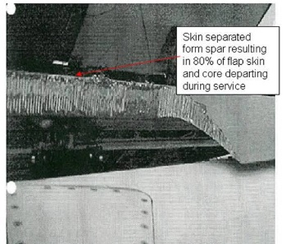
Example – Flap Wedge
Actual Outcome
What actually happened…
  Repair was accepted without proving HFA process and failed in service
  In flight, passenger observed severe damage to outboard “flap”
    Roughly 80% of trailing edge wedge assembly missing
    Investigation revealed skins disbonded from spar
    Spar HFA surface preparation inadequate
Reference:
NONCONFORMING COMPOSITE REPAIRS: Case Study Analysis, Seaton, Ilcewicz

Slide 26
Case Study Write-up
Case Study #1 Draft #3 for CMH-17
CS#1 Write-up emphasizes…
  Bond process is integration of inter-dependent sub-processes
    ALL must be rigorously followed to produce consistently sound structure.
    Reference [1] provides comprehensive check-list for the entire process
  Validation of both initial and long-term bond strength
  Age effects on bond strength (hydration)
    Discriminator tests to assess potential for long-term strength performance
  Substantiation guidelines
    Mechanical tests recommended for substantiation
  Concludes showing existence of public data invalidating the surface preparation substitution (HFA in lieu of PAA)

Slide 27
Case study #2:
Fuselage Skin damage

Slide 28
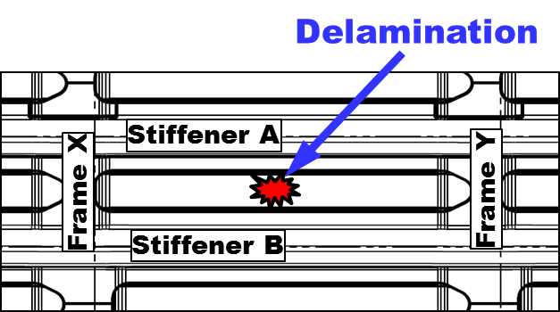
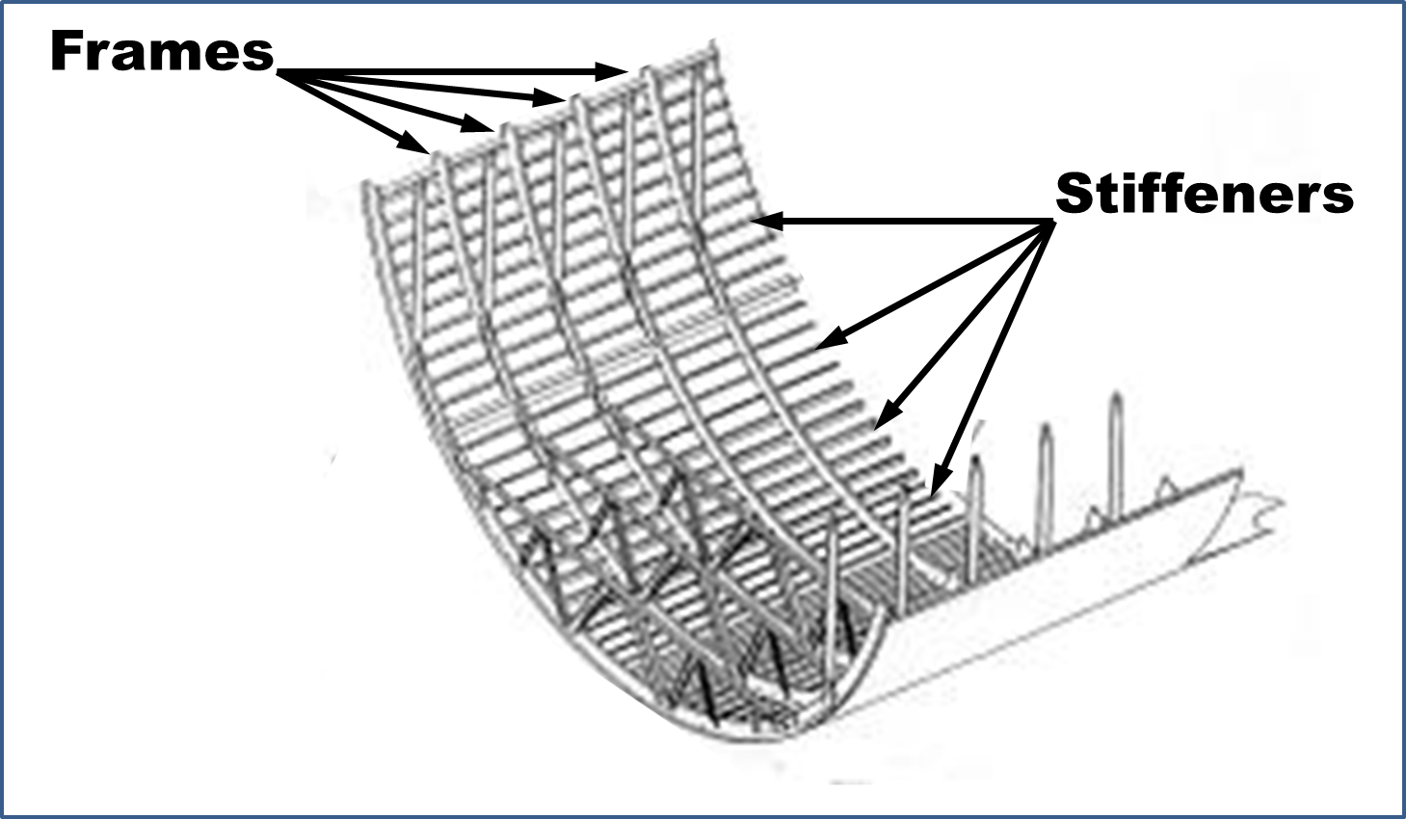
Case Study #2 – Composite Fuselage Repair
Description of Damage
RDL = Repairable Damage Limit
Description of Fictitious Damage
  Component: Composite Commercial Transport Fuselage
  Damage:
    Visible impact damage > SRM RDL
      Dispersed delaminations at up to 70% depth from OML
        i.e., there is no penetration of the skin
      Centered between stiffeners A and B at mid frame-bay
      Damage to skin only (no stringer or interface bond damage?)
    Location visible on walk around

Slide 29
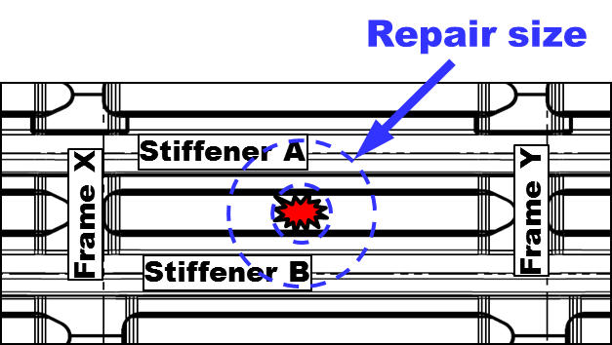

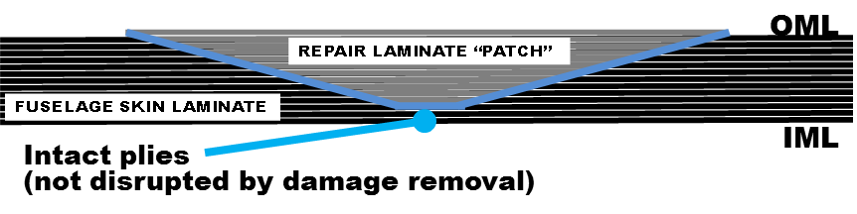
Case Study #2 - Fuselage Repair
Proposed Repair
Repair Proposed
    Remove damage from OML
    Apply flush bonded repair
      Partial-depth taper sand
    Surface prep per SRM
    Cure per SRM
    Patch material per SRM
    Adhesive per SRM
    Ply for ply replacement per SRM
    Lightning strike restoration per SRM
    Finish restoration per SRM

Slide 30
Some Considerations In Substantiating the Proposed Repair
Emerging composite commercial transport fuselages are mostly “sized” by “black box” stress analysis methods
  Very limited insight into methods or failure criteria
Design strains set by testing “configured” panel
  Only somewhat characterized using simple CAI tests
Generally, Skin is post-buckled at ultimate load
  Buckling induces out-of-plane stresses on stiffener bond-lines
  Tension failure criteria for bonds not well characterized
    Generally use conservative estimate
Yesterday’s paradigm of closed form analysis solutions not validated as relevant
Yet… we have to define a way-forward

Slide 31
Case Study #2 - Fuselage Repair
WG e-mail Feedback
RDL = Repair Damage Limit
  How is “RDL” defined for the case? Per guidance?
  Discuss that RDL’s are determined more than one way and no assumption of LIM capability is implied.
Is damage truly to skin only?
  What protocol used to discount potentially deleterious shock effects to bond or bond interface of frames and stiffeners with skin?
What data legitimizes the repair per SRM?
  Fully applicable dedicated tests with such configurations realized?
    Are they reflective of intended installation environment?
Should write-up discuss LDC?
Considering not only bonding but bolted repairs and cases will exist where bolting and bonding are allowed to increase the gage for fastener margins
Provide sense all things are not black and white.

Slide 32
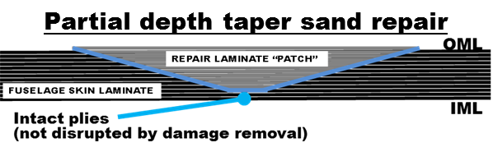
SoBR WG Comments From Previous Meetings
Damage tolerance and fatigue assessment of intact repair must be performed
  Repair has to be good for Cat 1 damage
Repair with Cat 2 damage must be capable of inspection interval
  Typically don’t repair cat 2 then assume subsequent cat 2 at same location
  If you’re not showing capability to Cat 2 insp. int. then must have story
  May not be okay to assume Cat 2 can’t happen twice in same spot
  Local threat level assessment required?
Patch off/BRSL – is for the one manufacturing defect “weak bond”
  Privilege - because believed weak bonds occur a very small fraction of the time.
    Reason for process rigor
  Don’t look at other damages or fatigue loadings in patch-off state
Patch-on BVID must be capable of ultimate load
Full damage tolerance required in patch-on condition
Inspection standards required to find manufacturing defects in patch-on condition
Demonstrate fail safe in “patch off” condition

Slide 33
SoBR WG Comments From Previous Meetings
25.609 - identify why significant substantiation not required for corrosion
Paint thickness must be considered (Lightning and dielectrics)
25.605 - We are outside the SRM envelop it may or not be adequate to point to SRM as the validative document
  Don’t want “cowboys” making that decision
  SRM may be size limited based on location and heat sinks, etc
  May degrade the process rigor
25.619 for a check point (to ensure it is considered)
  Certain products or applications may still have a need for special factors for process variability (GA aircraft many certified primarily by test)
  Some specific design criteria invoke special factors covering uncertainty

Slide 34
SoBR WG Comments From Previous Meetings
Don’t know how anyone who is not the OEM can pull off a repair outside SRM limits
  Requires a paragraph(s) to describe the impossibility of the task
  Likely impossible for non-OEM to build the data package to support PSE repair
New folks need guidance on what the mountain contains
  Need case studies showing “some path to a safe solution”
  May include “stop here unless you are an OEM”
So, let’s say someone indeed climbs the mountain.
  Has to be realized the SRM process have implied limits
Can’t use an un-configured panel to set basis for equivalency
All processes must be qualified
  Even if you “built it to the drawing” you are not qualified
Bombardier: Had a case with a reputable suppler who proposed an equivalent strength approach. Convinced they could do it, but were not allowed. In the end it was a bolted metal repair.
Sooner or later the OEM stops maintaining a product. Then who is in the acceptance mode. Is it realistic to think they will throw the airplane away? No. They will actually try to gain approval based on “some form” of data. Always helps to have the benchmarks…

Slide 35
SoBR WG Comments From Previous Meetings
Concern BRSL will provide a path.
  Might be argued, BRSL allows LL capability with zero margin; therefore, the arrestment features will be spaced such that they meet the original BVID and fatigue requirements
    Have you proved closely spaced arrestment features meet all other requirements?
  SRM size limit may not be residual strength limited
    Larger dimension may not be compatible with the materials and processes in the SRM.
  Limit load allowance is limited to coverage of one manufacturing defect
  All other defect coverages must still be considered.
  Disbond arrestment features may effect other things in a negative way.
Can safely assume the effects of temperature and moisture were taken into account for SRM allowances
Size of repair is key issue to need (or not) for allowables development
  Can you show by a limited number of tests that the size limit increase did not violate the assumptions in the allowables development?
For testing: Need representative of SRM and also structure representing the actual repair performed.
Include caution on w/D scale effect

Slide 36
Case Study #2 - Fuselage Repair
WG e-mail Feedback
Material and fabrication
  Assume full M&P coverage as per SRM (as outlined in case study brief)
  QA needs to demonstrate conformity with the process
FAA/EASA BRSL policy paper
  Residual strength above DLL needs to be demonstrated with failed repair
Static, fatigue and damage tolerance requirements
  Repair will require full substantiation:
    Applied static loads and fatigue spectrum must be established
    Analysis must be supported by test evidence
  Building block type approach in repair substantiation
  Detail and sub-component (static and fatigue) tests required to substantiate applicable analysis method – especially for out-of-plane and bi-directional loading
  The repair zone, as proposed in schematic, is in proximity to stringer flange, thus potentially introducing complex loading and stress states in the bond line. Bolts to mitigate bond damage from impact if allowed by SRM?
Economic considerations
  Coupons, details and sub-component testing involved in substantiating such a repair would be very costly (probably cost prohibitive) due to lack of access to OEM data

Slide 37
Case Study #2 - Fuselage Repair
Internal Health/Quality Evaluation
Additional topics for SoBR discussion
  What NDI technique is the bare essential?
  Do inspection standards exist?
  Material age and out-time
  Cure cycle importance and considerations
  Compliance of testing and calibrated equipment
  …

Slide 38
Proposed Case Study Candidates
Bonding principles ✓
Fuselage skin-only damage (no puncture) ✓
  Fuselage skin-only damage (no puncture) with adhesive change
  Fuselage skin-only damage (no puncture) with patch laminate material change
Fuselage skin-only damage with puncture
Fuselage skin+stiffener damage
Fuselage skin+stiffener+frame damage
Nacelle panels (inlet, fan cowl, TR, D-Duct IW)?
What others do you suggest?

Slide 39
SoBR WG Membership
Meetings once per month for 2 hours
“Homework” between meetings
Desire additional experienced membership
Contact:
  Michael Borgman
  michael.d.borgman@spiritaero.com
  +1 316 523 6783
  Please send email request to join WG including brief description of your bonded repair experience base

Slide 40
END
Thanks for you attention

